Slide 1
Intermediate RStudio Training
January 23, 2018

Slide 2
Course Outline
Clusters
Outliers
Regression
Text Analytics
Q & A

Slide 3
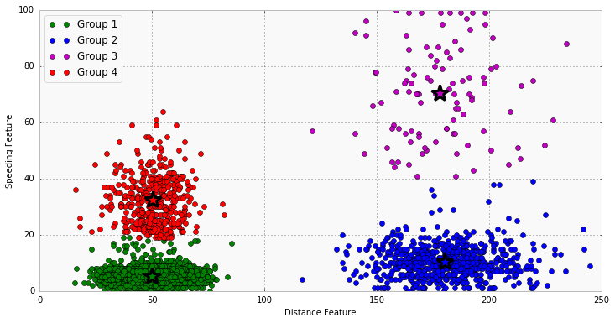
Clustering
Grouping of similar objects in multivariate data set
Example: grouping by distance from a center
Variable 1
Variable 2

Slide 4
Clustering with k-means()
kmeans() clustering is the most commonly used algorithm for partitioning a given data set into a set of k groups/clusters
k represents the number of groups pre-specified by the analyst. It classifies objects in multiple groups (i.e., clusters), such that objects within the same cluster are as similar as possible
In k-means clustering, each cluster is represented by its center (i.e, centroid) which corresponds to the mean of points assigned to the cluster
kmeans(x, centers, iter.max = 10, nstart = 1,
algorithm = c("Hartigan-Wong", "Lloyd", "Forgy",
"MacQueen"), trace=FALSE)
nstart() is optional parameter in kmeans() setting initial number of configurations, e.g. nstart=25 will generate 25 initial random centroids and choose the best one for the algorithm
set.seed(seed) is random number generator, which is useful for creating simulations or random objects that can be reproduced, required by nstart()

Slide 5
R Script for k-means
library(ggplot2)
ggplot(iris, aes(Petal.Length, Petal.Width, color = Species)) + geom_point()
set.seed(20)
irisCluster <- kmeans(iris[, 3:4], 3, nstart = 20)
irisCluster
table(irisCluster$cluster, iris$Species)
irisCluster$cluster <- as.factor(irisCluster$cluster)
ggplot(iris, aes(Petal.Length, Petal.Width, color = irisCluster$cluster)) + geom_point()
Or:
ggplot(iris, aes(y = Petal.Length, x = seq(1, length(iris$Sepal.Length)), color = irisCluster$cluster)) + geom_point()
irisCluster1 = kmeans(iris[,3], 3, nstart = 20)
irisCluster1
table(irisCluster1$cluster, iris$Species)

Slide 6
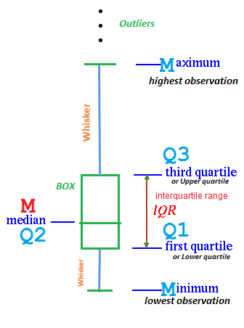
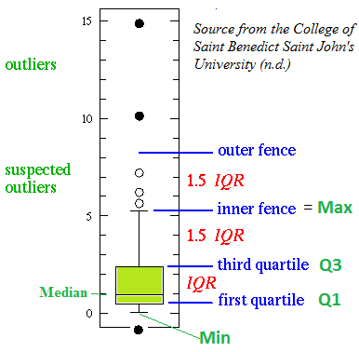
Outliers with Boxplots

Slide 7
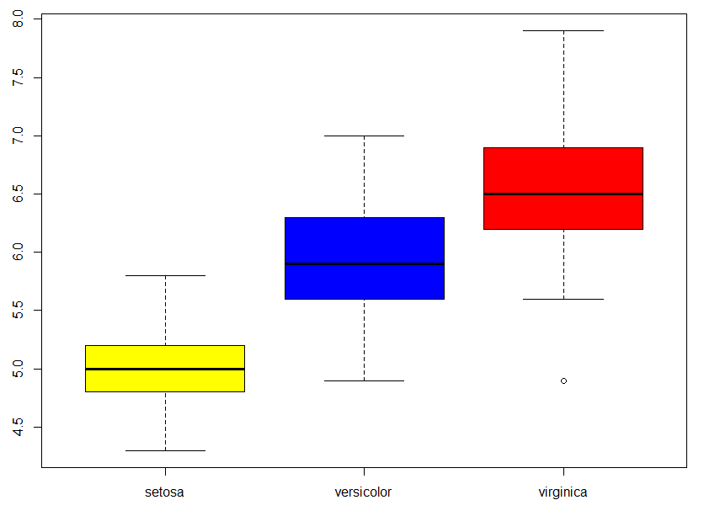
Outliers in Iris Boxplot
boxplot(Sepal.Length ~ Species, data=iris, col= c("yellow", "blue", "red"), ylab="Sepal Length")
Why this sample is an outlier?
Lets explore boxplot defaults:
boxplot.default(x, ..., range = 1.5, width = NULL, varwidth = FALSE, notch = FALSE, names, data = sys.frame(sys.parent()), plot = TRUE, border = par("fg"), col = NULL, log = "", pars = NULL)

Slide 8
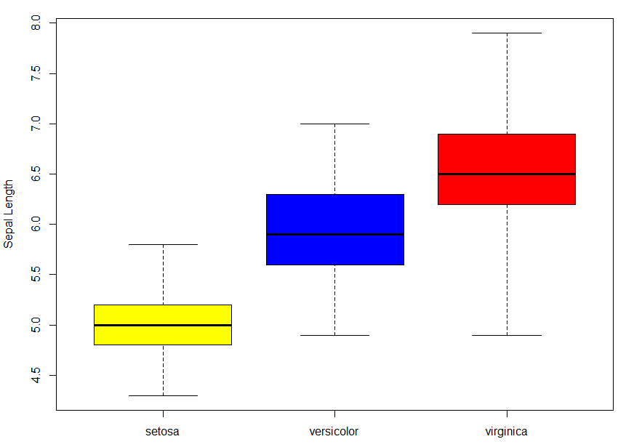

Outliers in Boxplot
by Changing Range
boxplot(Sepal.Length ~ Species, data=iris, range = 0, col= c("yellow", "blue", "red"), ylab="Sepal Length")
boxplot(Sepal.Length ~ Species, data=iris, range = 1, col= c("yellow", "blue", "red"), ylab="Sepal Length")
Range = X determines how far the plot whiskers extend out from the box. X is a multiplier for the IQR value. X = zero causes the whiskers to extend to the data extremes (min/max).

Slide 9
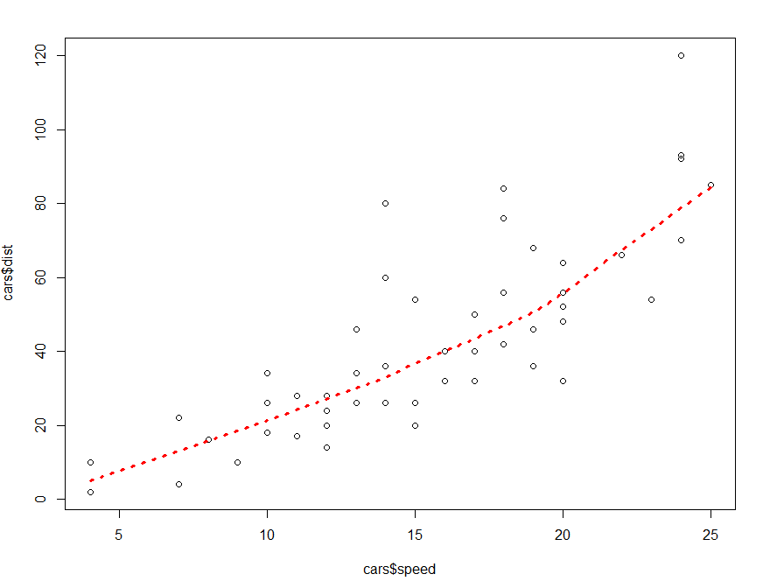
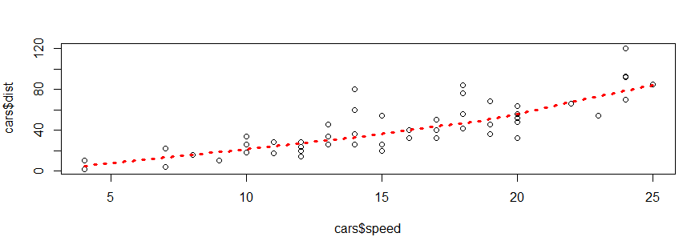
Regression with Scatter Plot
scatter.smooth(x = cars$speed, y = cars$dist, lpars = list(col = "red", lwd = 3, lty = 3))
OR with linear model:
linearMod = lm(dist ~ speed, data=cars)
print(linearMod)
Coefficients:
(Intercept) speed
-17.579 3.932
dist = Intercept + (β ∗ speed)
=> dist = −17.579 + 3.932∗speed

Slide 10
Text Mining
Natural languages are different from programming languages
The semantic or the meaning of a statement depends on the context, tone and other factors
Unlike programming languages, natural languages are ambiguous
Text mining deals with helping computers understand the “meaning” of the text.
Some of the common text mining applications include sentiment analysis e.g if a tweet about a movie says something positive or not, text classification e.g classifying the mails you get as spam or ham etc.

Slide 11
Text Preprocessing
Text data contains white spaces, punctuations, stopwords etc.
These characters do not convey much information and are hard to process.
For example, English stopwords like “the”, “is” etc. do not tell you much information about the sentiment of the text, entities mentioned in the text, or relationships between those entities.
Depending upon the task at hand, we deal with such characters differently.
Preprocessing includes
Convert the text to lower case, so that words like “write” and “Write” are considered the same word for analysis
Remove numbers
Remove English stopwords e.g “the”, “is”, “of”, etc
Remove punctuation e.g “,”, “?”, etc
Eliminate extra white spaces
Stemming our text

Slide 12
Text Processing Vocabulary
NLP – natural language processing
Corpus (pl. corpora) – large structured set of texts
Stopwords – words (such as “the”, “is”, “etc”) that are ignored by search engines
Stemming - reduce “infected”/derived word to their stem, e.g. “cars” to “car”
Lemmatization – distinguish “saw” – hand tool – from “saw” past form of “see”, remove “inflectional” endings to return the base of a word known as lemma
N-grams – continuous sequence of n items from text, e.g.: phonems, syllables, letters, words, base pairs
Tokenization – breaking of texts (strings) into pieces (words, sentences, phases, symbols - tokens) for further analysis.

Slide 13
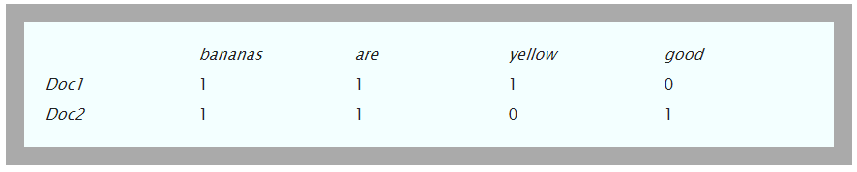
Document Term Matrix
DTM is a matrix that lists all occurrences of words in the corpus, by document
The documents are represented by rows and the terms (or words) by columns
If a word occurs in a particular document, then the matrix entry for corresponding to that row and column is 1 (2 if twice, and so on), else it is 0
Example: Assume we have a simple corpus consisting of two documents, Doc1 and Doc2, with the following content:
Doc1: bananas are yellow
Doc2: bananas are good
The DTM for this corpus would look like:
If we transpose rows and columns we will get TDM

Slide 14
Text Analytics Steps
Create Corpus
Preprocess
Optional: Lemmatization
Create TDM (or DTM) data frame
Rows - document number
Columns – words
Cells – frequency of a word in a doc
Generate 1-gram, bigram and trigram matrices
Analyze
Create summaries
Compute Statistics
Visualize
Histograms
Word clouds

Slide 15
Sentiment Analysis Steps
Create Corpus
Preprocess
Stem text
Optional: Lemmatization
Create a subset (training data)
Manually assign sentiment (e.g. positive Vs. negative
(or use sentiment vocabulary)
Create sentiment score table:
Rows - document number
Columns – words
Cells – score(s) for each word: how often it shows in negative/positive documents
Test the scores on the test data to obtain confidence level
Apply sentiment scores to all documents for overall results

Slide 16
Text Analytics: Wordcloud
# i have a dream wordcloud
# Load
library("tm")
library("SnowballC")
library("wordcloud")
library("RColorBrewer")
# Read the text file from internet
filePath <- "http://www.sthda.com/sthda/RDoc/example-files/martin-luther-king-i-have-a-dream-speech.txt"
text <- readLines(filePath)
# Load the data as a corpus
docs <- Corpus(VectorSource(text))
inspect(docs)
# text transformation replacing “/”, “@” and “|” with space:
toSpace <- content_transformer(function (x , pattern ) gsub(pattern, " ", x))
docs <- tm_map(docs, toSpace, "/")
docs <- tm_map(docs, toSpace, "@")
docs <- tm_map(docs, toSpace, "\\|")
# text cleaning
# Convert the text to lower case
docs <- tm_map(docs, content_transformer(tolower))
# Remove numbers
docs <- tm_map(docs, removeNumbers)
# Remove english common stopwords
docs <- tm_map(docs, removeWords, stopwords("english"))
# Remove your own stop word
# specify your stopwords as a character vector
docs <- tm_map(docs, removeWords, c("blabla1", "blabla2"))
# Remove punctuations
docs <- tm_map(docs, removePunctuation)
# Eliminate extra white spaces
docs <- tm_map(docs, stripWhitespace)
# Text stemming
# docs <- tm_map(docs, stemDocument)
# build tdm
dtm <- TermDocumentMatrix(docs)
m <- as.matrix(dtm)
v <- sort(rowSums(m),decreasing=TRUE)
d <- data.frame(word = names(v),freq=v)
head(d, 10)
# generate wordcloud
set.seed(1234)
wordcloud(words = d$word, freq = d$freq, min.freq = 1,
max.words=200, random.order=FALSE, rot.per=0.35,
colors=brewer.pal(8, "Dark2"))

Slide 17
R References
https://www.tidytextmining.com/tidytext.html
http://garrettgman.github.io/tidying/
https://www.r-bloggers.com/intro-to-text-analysis-with-r/
https://eight2late.wordpress.com/2015/05/27/a-gentle-introduction-to-text-mining-using-r/
Required packages: tm, SnowballC, ggplot2, wordcloud
Tutorial: https://www.springboard.com/blog/text-mining-in-r/ w/ Hillary’s emails
Packages for tutorial
RSQLite, ‘SQLite’ Interface for R
tm, framework for text mining applications
SnowballC, text stemming library
Wordcloud, for making wordcloud visualizations
Syuzhet, text sentiment analysis
ggplot2, one of the best data visualization libraries
quanteda, N-grams
Datasource: https://www.kaggle.com/kaggle/hillary-clinton-emails
Quanteda
https://cran.r-project.org/web/packages/quanteda/vignettes/quickstart.html

Slide 18
Q & A

